Slide 1

OBJECT-ORIENTED PROGRAMMING
Array - String

Slide 2
Outline
Array:
Create array
Process array
Foreach loops
Passing Arrays to Methods
Return Arrays from Methods
Arrays class
[503005 Lecture 3: Array - String]

Slide 3
Outline
String:
charSequence Interface
Create string
String methods
[503005 Lecture 3: Array - String]

Slide 4
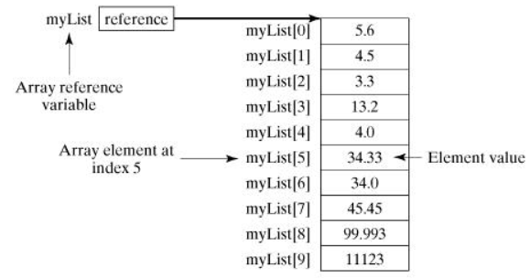
Arrays

Slide 5
Arrays
Create Arrays
dataType[] arrayRefVar = new dataType[arraySize];
Example:
double[] myList = new double[10];
[503005 Lecture 3: Array - String]

Slide 6
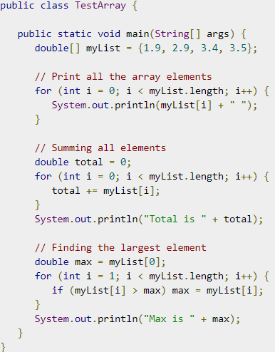
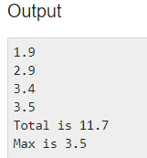
Process Arrays
We often use either for loop or foreach loop because all of the elements in an array are of the same type and the size of the array is known
[503005 Lecture 3: Array - String]

Slide 7
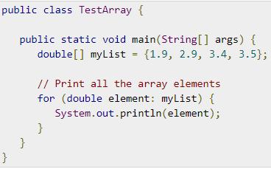

Foreach Loops
JDK 1.5 introduced a new for loop known as foreach loop or enhanced for loop, which enables you to traverse the complete array sequentially without using an index variable
[503005 Lecture 3: Array - String]

Slide 8
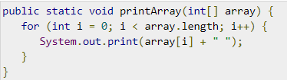
Passing Arrays to Methods
We can invoke it by passing an array. For example, the following statement invokes the printArray method to display 3, 1, 2, 6, 4, and 2
[503005 Lecture 3: Array - String]

Slide 9
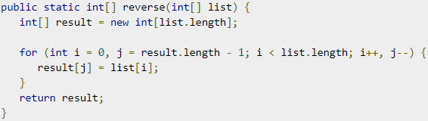
Return an Array from a Method
A method may also return an array. For example, the following method returns an array that is the reversal of another array
[503005 Lecture 3: Array - String]

Slide 10
Java String
charSequence Interface
Create string
String methods
[503005 Lecture 3: Array - String]

Slide 11
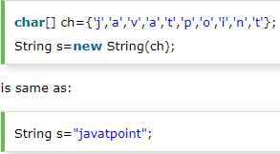
Java String
In Java, string is basically an object that represents sequence of char values. An array of characters works same as Java string. For example:
[503005 Lecture 3: Array - String]

Slide 12
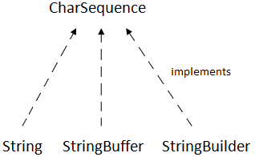
CharSequence Interface
The Java String is immutable which means it cannot be changed. Whenever we change any string, a new instance is created. For mutable strings, you can use StringBuffer and StringBuilder classes (
[503005 Lecture 3: Array - String]

Slide 13
Create String
There are two ways to create String object:
By string literal
By new keyword
[503005 Lecture 3: Array - String]

Slide 14

Create String
By string literal
String s="welcome";
Each time you create a string literal, the JVM checks the "string constant pool" first. If the string already exists in the pool, a reference to the pooled instance is returned. If the string doesn't exist in the pool, a new string instance is created and placed in the pool. For example:
[503005 Lecture 3: Array - String]

Slide 15
Create String
By new keyword
String s=new String("Welcome");//creates two objects and one reference variable
In such case, JVM will create a new string object in normal (non-pool) heap memory, and the literal "Welcome" will be placed in the string constant pool. The variable s will refer to the object in a heap (non-pool)
[503005 Lecture 3: Array - String]

Slide 16
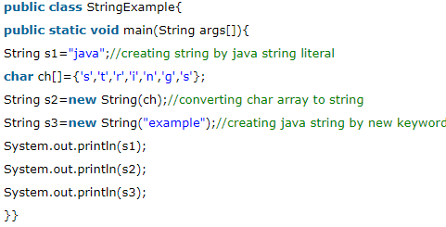

Create String
[503005 Lecture 3: Array - String]

Slide 17
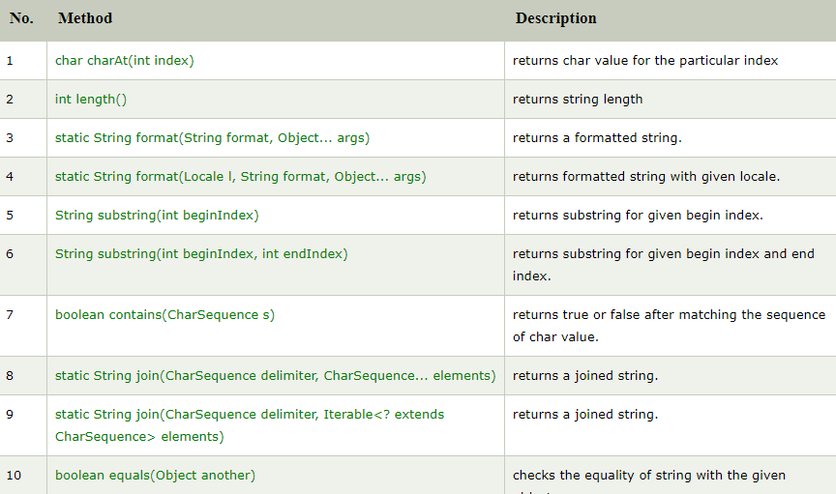
String methods
[503005 Lecture 3: Array - String]

Slide 18
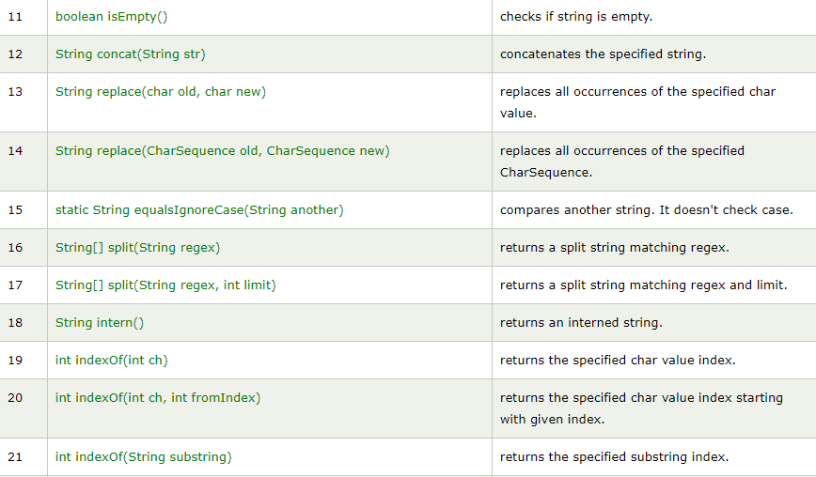
String methods
[503005 Lecture 3: Array - String]

Slide 19
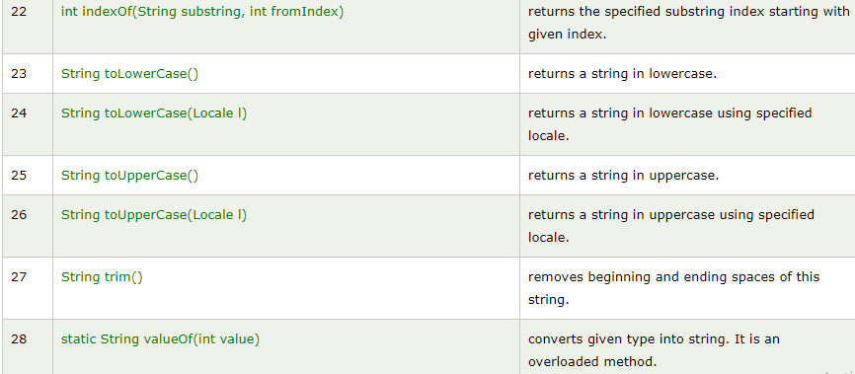
String methods
[503005 Lecture 3: Array - String]

Slide 20
Read more
StringBufer class: https://www.javatpoint.com/StringBuffer-class
StringBuilder class: https://www.javatpoint.com/StringBuilder-class
[503005 Lecture 3: Array - String]

Slide 21
Exercises
Arrays
Input and Output a 1D-Array with n integer values
List negative values in the array
Find max value in the array
Find the first position of negative values in the array
Calculate sum of values in the array
Sort the array in ascending order
Add an element x to the first position of the array
Delete the first greater 0 element in the array
[503005 Lecture 3: Array - String]

Slide 22
Exercises
String:
Given a Vietnamese full name (ex “Nguyen Tran Minh Tuan”). Students need to write methods as follows:
Count how many words in the name. (Count: 4)
Return a first name (Tuan)
Return a last name (Nguyen)
Return a middle name (Tran Minh)
Capitalize the first character in each word of the name (Ex: “Nguyen tran Minh tuan” -> “Nguyen Tran Minh Tuan”)
Formalize the name, including:
Delete all spaces in front and behind of the name.
Leave one space between the words of the name.
Ex: “ Nguyen Tran Minh Tuan ” -> “Nguyen Tran Minh Tuan”
[503005 Lecture 3: Array - String]

Slide 23
End of file

